Slide 1
MONITOR

Slide 2
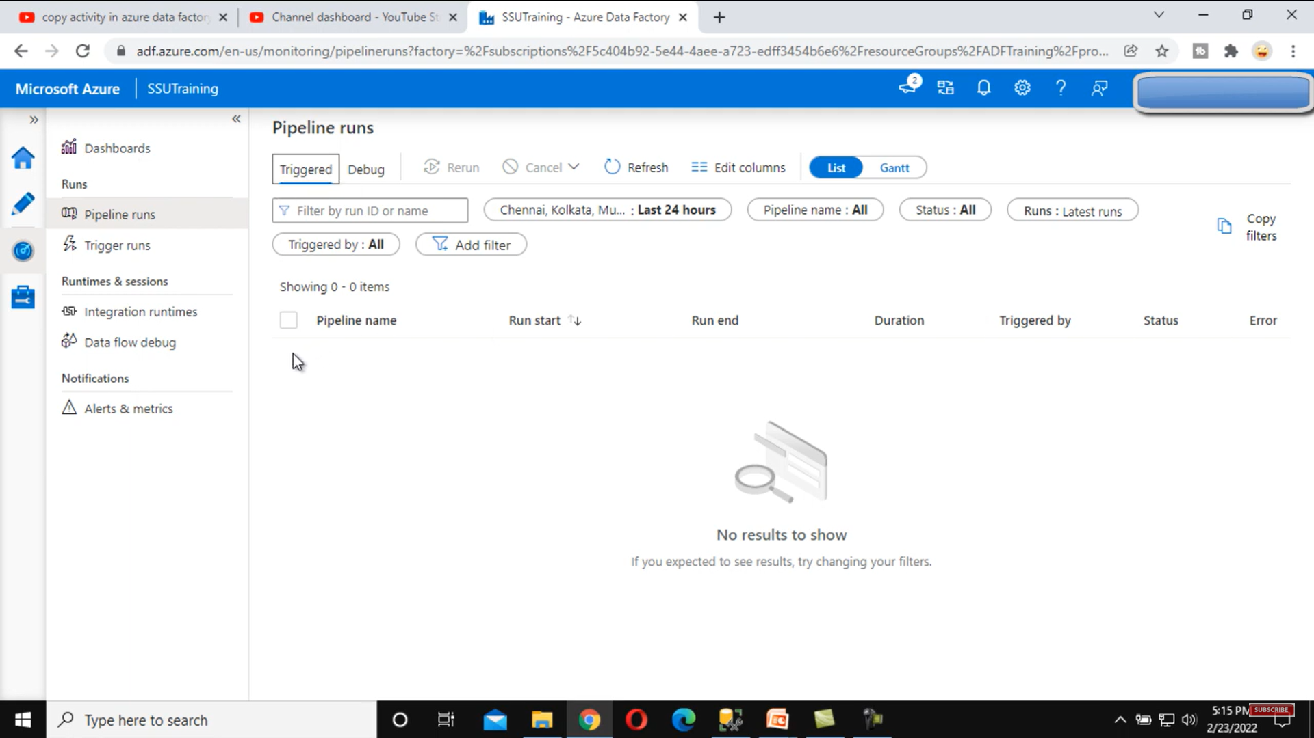
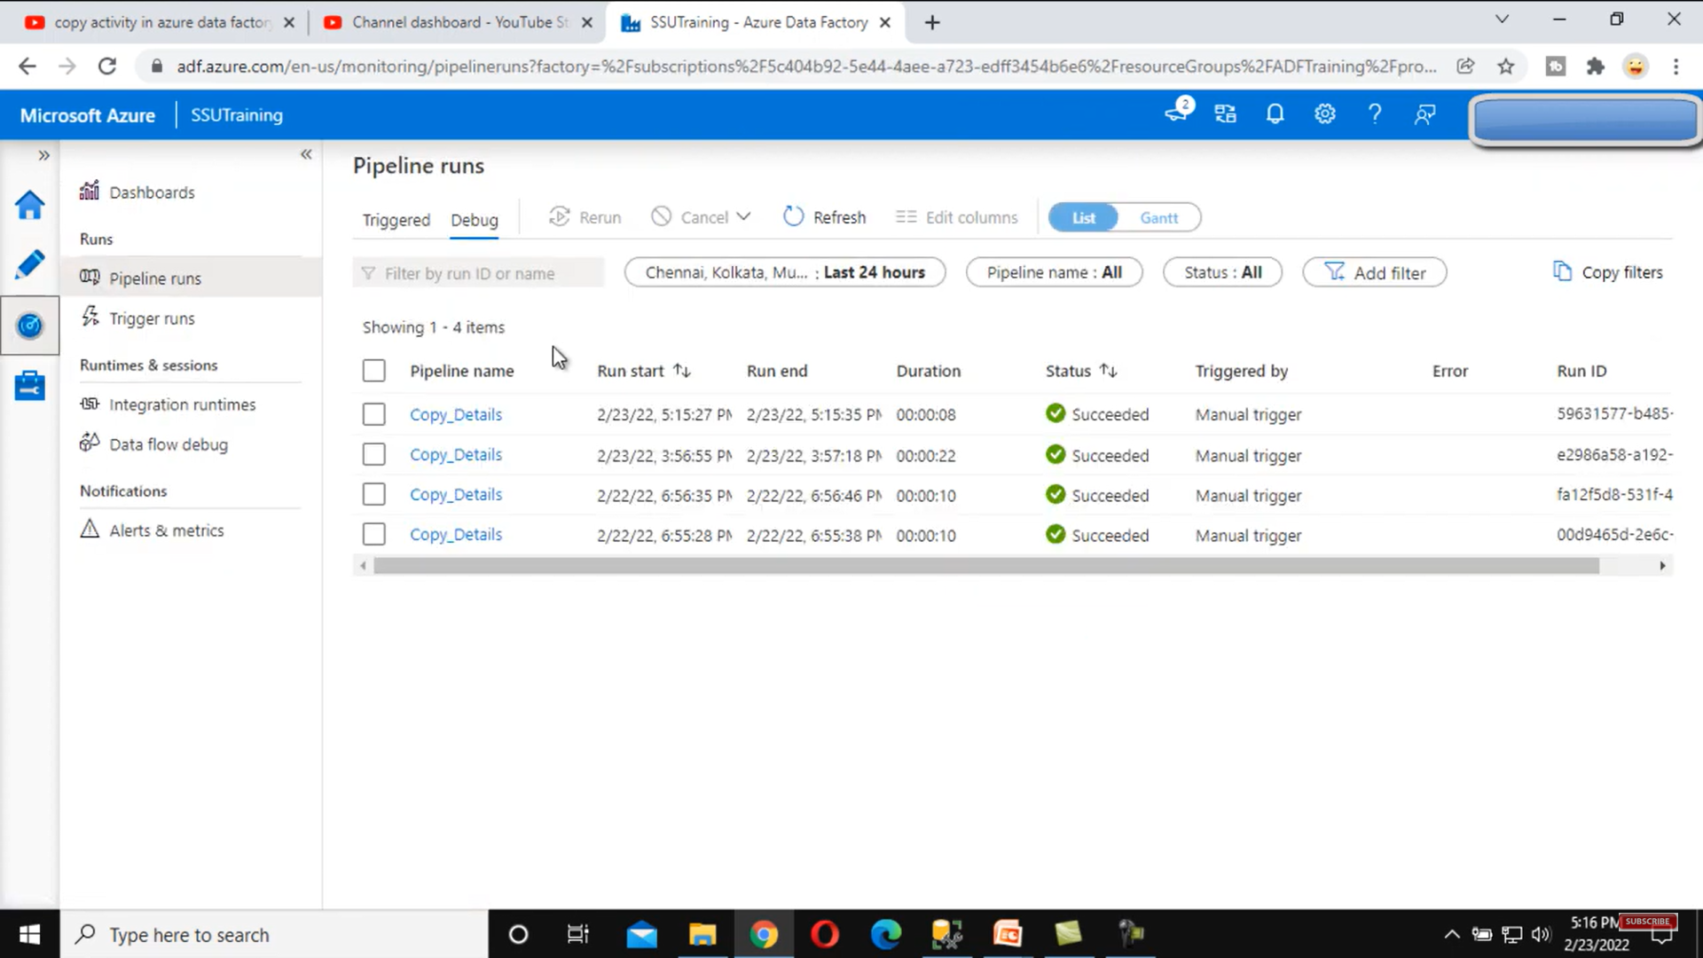

Slide 3
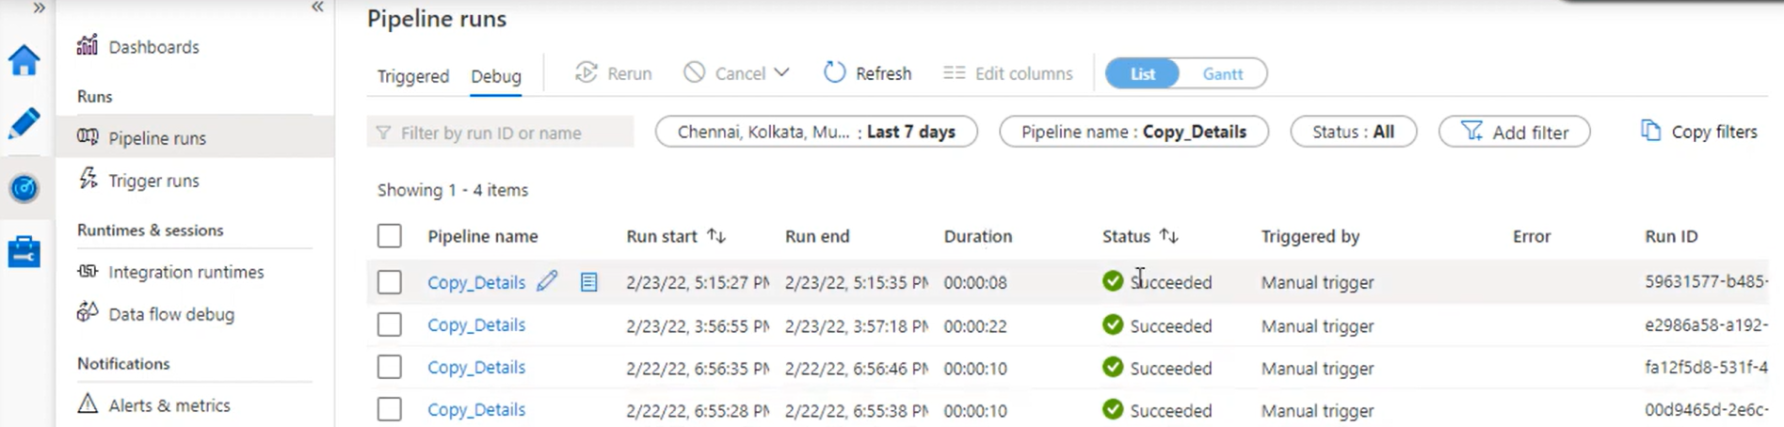
1
2
3
4

Slide 4
MONITOR --> Pipeline runs

Slide 5
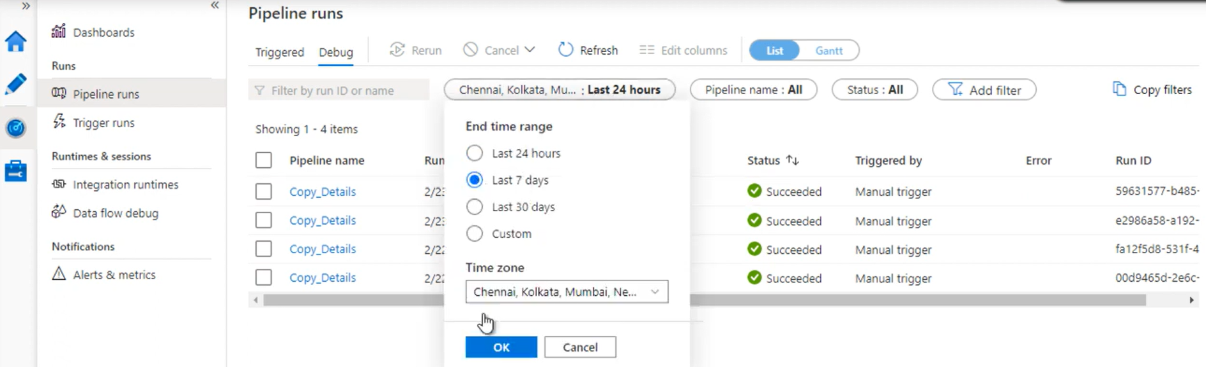

Slide 6
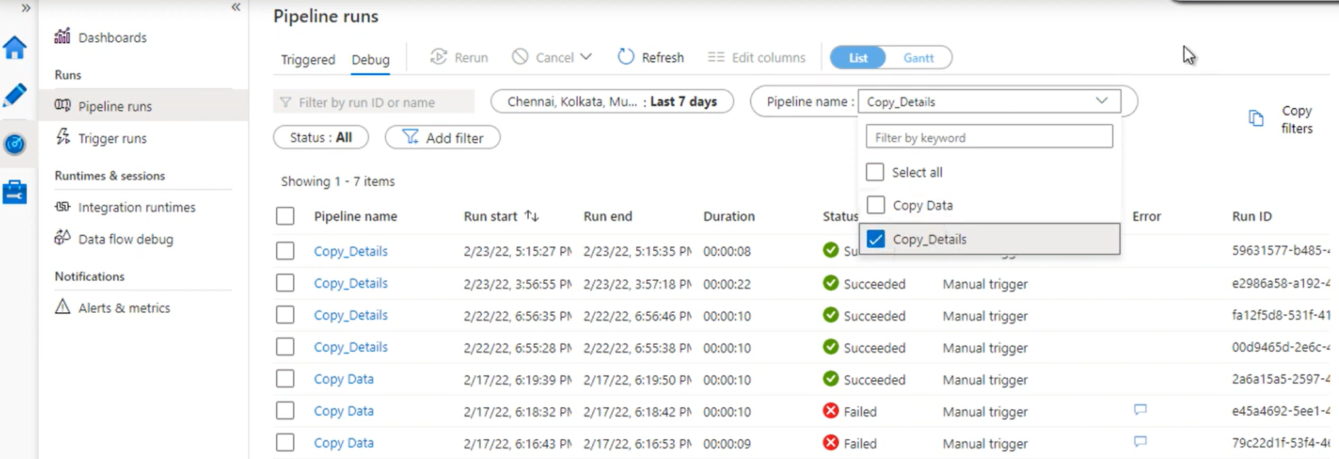

Slide 7
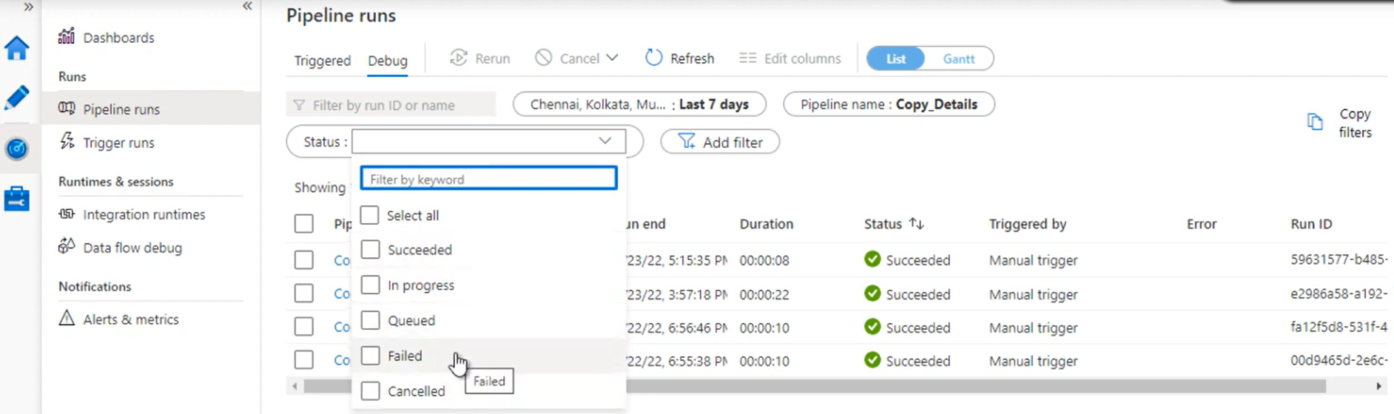

Slide 8
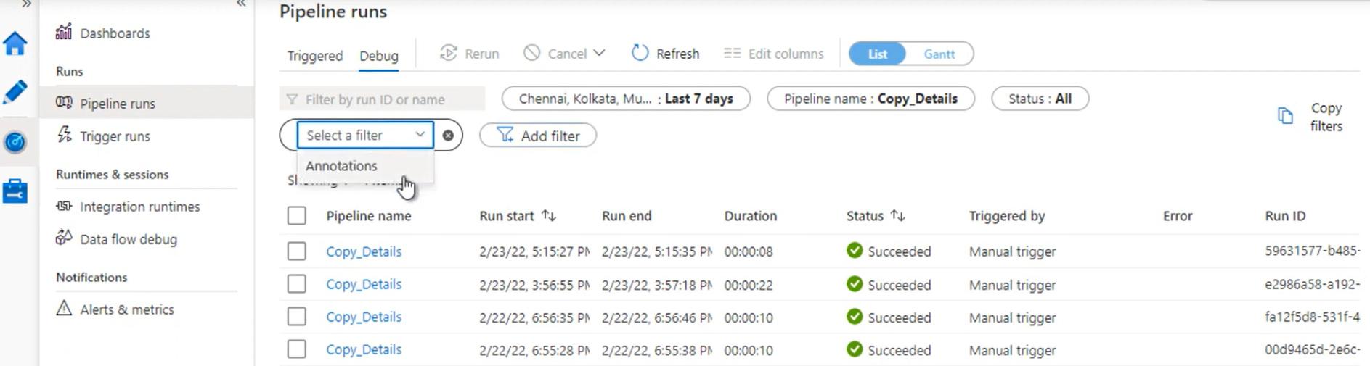

Slide 9
MONITOR --> Trigger runs

Slide 10
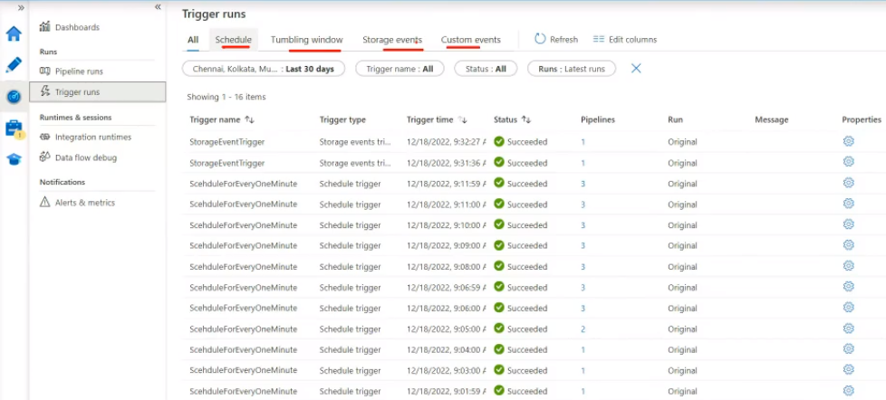
Monitor

Slide 11
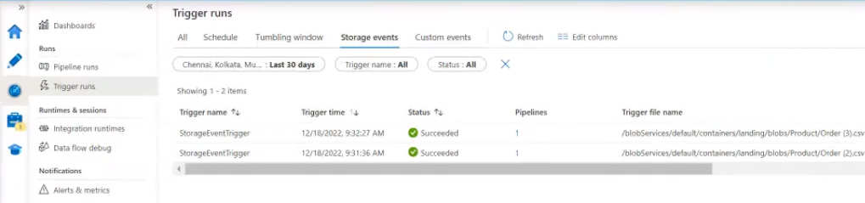

Slide 12
MONITOR --> integration runtimes

Slide 13
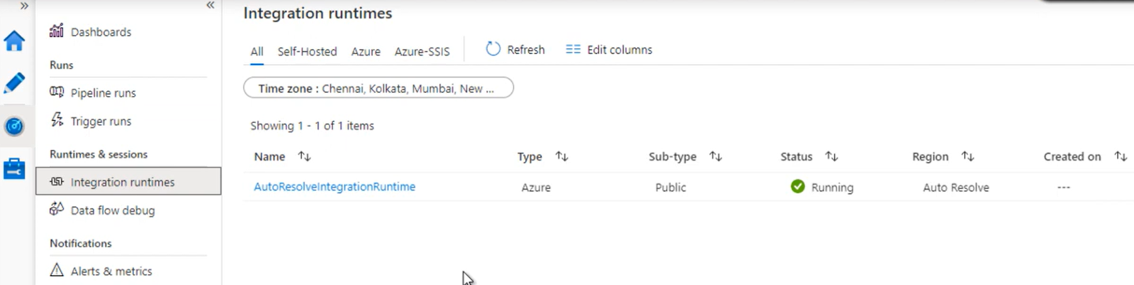

Slide 14
MONITOR --> Data flow debug

Slide 16
MONITOR --> Alerts and metrics

